Slide 1

Aqua Nature

Slide 2
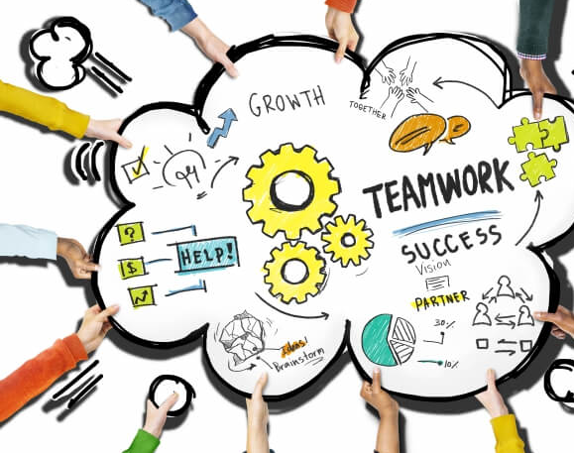
Something about our team
Stephan Danielov Stratev – Scrum Trainer
Alexander Zlatkov Yanev - Backend Developer
Denis Nikolaev Kolev – Backend Developer
Yoan Georgiev Dimitrov – Backend Developer
Kliment Georgiev Tenev – Frontend Developer
Martin Milev Mechkov – Designer

Slide 3
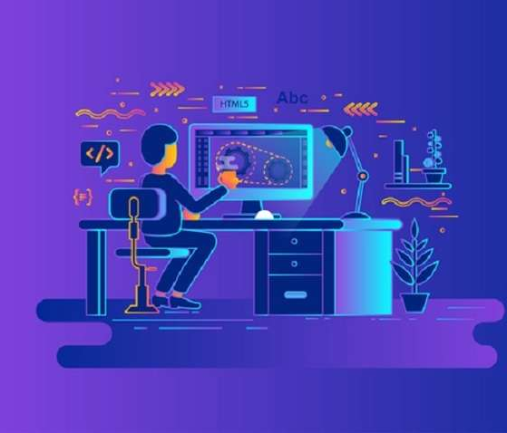

The topic of our project
The topic of our project, which consists of an application, a website and (an unfinished) database is to show people from all around the world about different animal species. It includes our protected Bulgarian national parks. We included them because we want to attract tourism from all around the world. Our team thinks that Bulgaria has some of the best nature from all around the world.

Slide 4
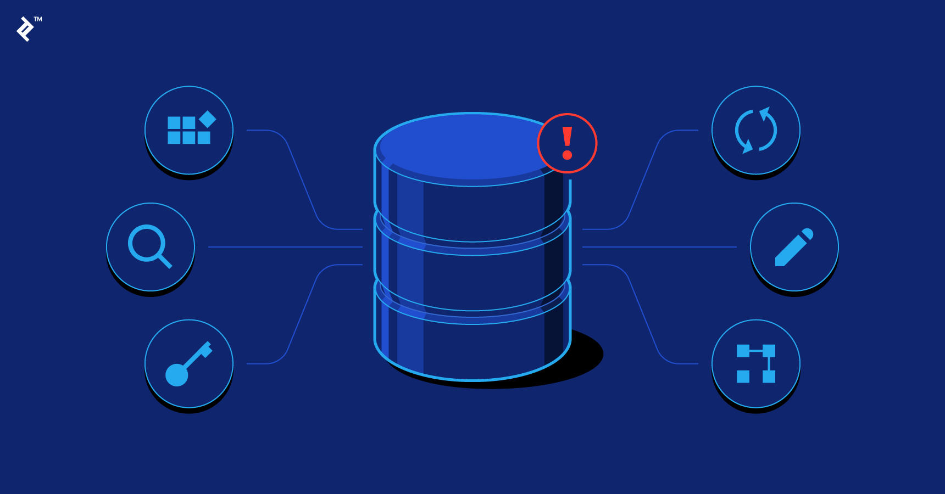
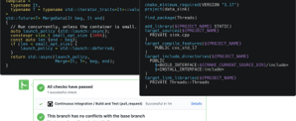
Contents
We are developing a site and a program, which will have up-to-date information on water resources and animals, protected aquatic animals, protected water areas as well as technological solutions for their protection, monitoring and development. You can look through our [presentation] for a better introduction.

Slide 5

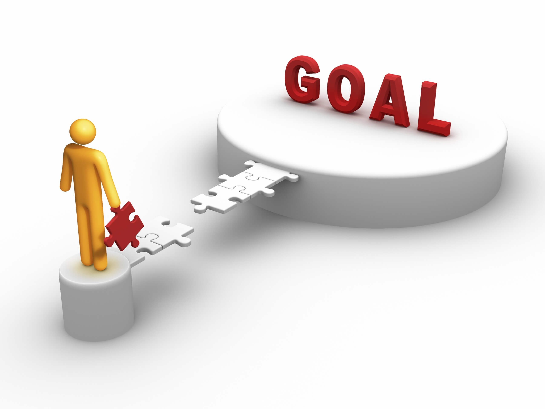
Goals
Our goal was to create a website that could possibly make people more interested in different animal species. Our first goal was to create the concept. The second goal was to create a simple to use site, that has all the necessary information. Our third goal was to create the database and the program. Our last but not least goal is to present our project to the jury and hopefully we do well!

Slide 6





Realization
Our Frontend developer and the designer started doing the site while our backend developers were doing the work on the program and the database. We mainly used Visual Studio for the program, Notepad++ for the site, SQL Server Management Studio for the database. We couldn’t connect the program with the database due our lack of time. We used GitHub for cooperative work. And Microsoft Teams for messaging the team and sending different files to each other.

Slide 7

Showing the documentation

Slide 8

Showing the site

Slide 9
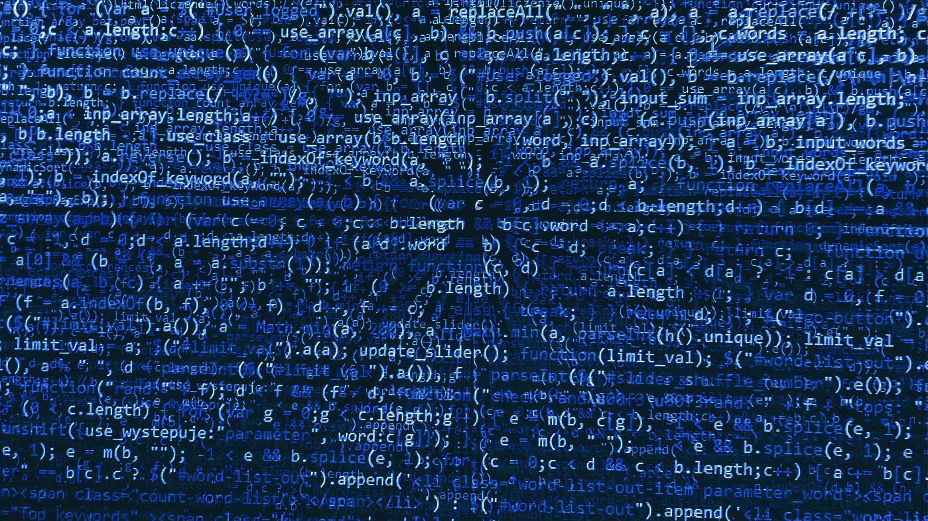
Showing the functionality of the code

Slide 10
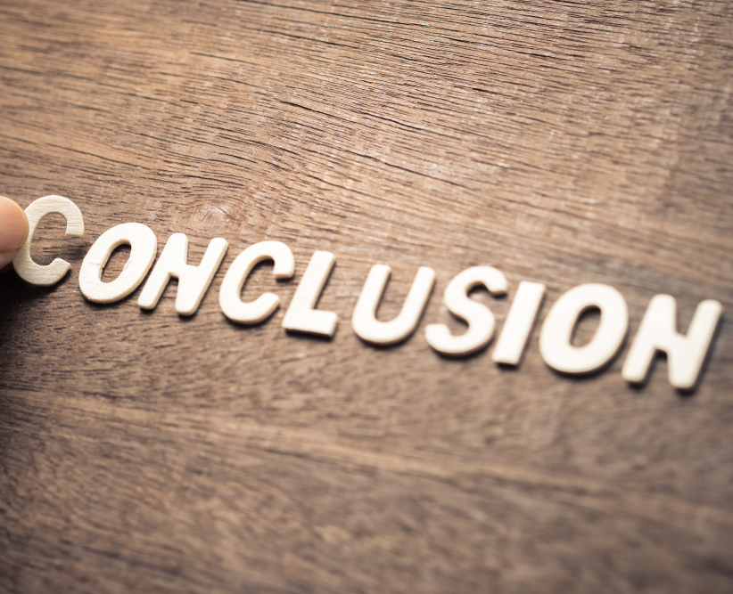

Conclusion
In conclusion, I think we could have done better. We didn’t organize our time well, because of the exams. Another thing was that it was the end of school, we had a lot of work to do for school. But we managed to do somethings that we think is well build and will work to influence people’s view on animal species and Bulgarian waters- rivers, sea and lakes.

Slide 11
Thank you for watching!
Made by Aqua Nature

